Slide 1
E-Cigarettes: Quitting Smoking or Picking up a New Habit(s)?
A. Purush Rao, MD
Associate Professor of Clinical Medicine
Keck School of Medicine
University of Southern California
Notes:
Good morning everyone. I would like to thank Dr. Friedman for the wonderful introduction and everyone for coming to my grand rounds. My topic today will focus on E-cigarettes. I chose this topic because e-cigarettes are becoming very popular, and I was curious what the hype was all about.

Slide 2
Outline
Impact of Smoking on Health and Healthcare
Brief History of E-Cigarettes
How E-cigarettes work
Effectiveness
Safety
Public Health Concerns
Take Home Points
Notes:
I will start by briefly going over the impact of smoking on healthcare, Then I will talk about how E-cigarettes were developed, how they work as well as the evidence that we have about their effectiveness and safety. We will wrap up with the public health concerns and the take home points for the housestaff

Slide 3
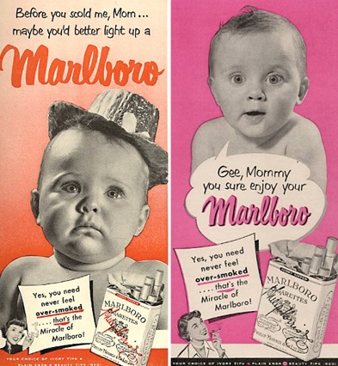
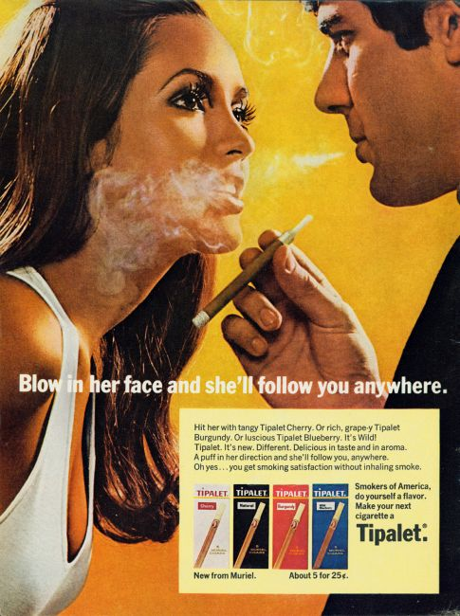

Promotion of smoking
Notes:
In the mid 1900’s, smoking was the popular thing to do. There were ads on tv, in newspapers and on the radio. Some used innocent little babies to sell their product while others made it look exciting and desirable. Let’s take a look at a brief clip from an ad in the 1960’s.

Slide 4

video
Notes:
As you saw in this clip, not only was smoking the popular thing to do in the mid-1900’s, it was also being promoted by our very own colleagues. The long term health effects of cigarettes were not known at that time. Some doctors were even suggesting that smoking might be good for you. However, this philosophy would steadily change and anti-smoking campaigns have become the norm in the world of medicine.

Slide 5
The Beginning of Anti-Smoking Campaigns
1964 – Surgeon General Advisory Committee on Smoking and Health
Linked cigarette smoking to
  Lung Cancer in Men
  Laryngeal (Throat) Cancer in men
  Chronic Bronchitis (irritation in the airway)
Notes:
In January of 1964, Luther L. Terry, the Surgeon General of the U.S. Public Health Service, released the first report of the Surgeon General's Advisory Committee on Smoking and Health.
On the basis of more than 7,000 articles relating to smoking and disease already available at that time, the Advisory Committee concluded that cigarette smoking was—
Definitely A cause of lung and laryngeal cancer in men
A probable cause of lung cancer in women and
The most important cause of chronic bronchitis
The release of this report was the first in a series of steps, which are still being taken more than 50 years later, in an attempt to diminish the impact of tobacco on the health of the American people

Slide 6
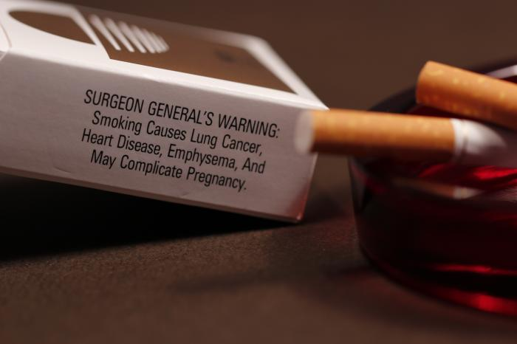
What We’ve learned
Cigarette smoking is the leading preventable cause of death in the United States
  More than 480,000 deaths each year in the United States
  Estimated that tobacco will cause 1 billion deaths in the 21st century
Notes:
Over the next 50 years, it has become well established that tobacco has become the LEADING CAUSE of preventable deaths in the US, and is responsible for more than 480K deaths each year, which means Nearly 1 in every 5 deaths is related to smoking tobacco.
More than 10 times as many U.S. citizens have died prematurely from cigarette smoking than have died in all the wars fought by the US.
Smoking causes more deaths each year than the combination of HIV, illegal drug use, alcohol use, motor vehicle accidents and fire-arm related incidents.
Worldwide, it’s estimated that tobacco will lead to 1 billion deaths by end of the 21st century.

Slide 7
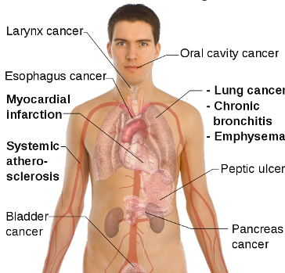
Impact on the Human Body
Notes:
This is a busy slide, but what I want you to get out of it, is that tobacco has negative effects on every organ system in the body…. and has been linked to several chronic diseases and cancers.
Smokers are more likely \to develop heart disease, stroke, and lung cancer than people who don’t smoke.
Smoking is estimated to increase the risk of coronary heart disease and stroke by 2-4 times and the risk of developing lung cancer by 25 times.

Slide 8




Tobacco Industry On The Run
President Clinton announces Food and Drug Administration’s plan to regulate tobacco, especially sales and advertising aimed at minors
Banned on all interstate buses and domestic airline flights
1971
1994
1990
1995
All broadcast advertising was banned
Mississippi files the first of 22 state lawsuits seeking to recoup millions of dollars from tobacco companies for smokers’ Medicaid bills
Notes:
Now that we know how harmful smoking is, we can understand why anti-smoking campaigns have intensified over the years. In 1971, all broadcast advertising was banned from television and radio. A couple decades later, smoking was banned on domestic flights. A few years after that, in 1995, president Clinton announced the FDA’s plan to regulate tobacco, with sales and advertising aimed at minors being banned. In more recent news, just last year, Hawaii became the first state to raise the tobacco sale age to 21 and many states are trying to push legislation to follow suit.

Slide 9
Cost of Smoking on Healthcare
Smoking causes increased healthcare utilization and cost
Total economic cost of smoking is more than $300 billion a year
  Nearly $170 billion in direct medical care for adults
  More than $156 billion in lost productivity
Notes:
In addition to all of the negative effects on health, smoking has also been associated with increased health care utilization and costs. Smoking costs the US billions of dollars each year. In 2014, the Center for Disease Control estimated that the total economic cost of smoking was more than $300 billion a year; with nearly 170 billion of those dollars used in direct medical care for adults.
Smoking has also been linked to increased absenteeism from work resulting in lost productivity and major economic losses.

Slide 10
Quitting is Beneficial
Quitting smoking greatly reduces the risk of developing smoking-related diseases
Nearly 7 out of 10 (68.8%) adult smokers reported in 2010 that they wanted to quit
Quitting smoking is difficult and may require several attempts
  80% of attempts to quit smoking fail within a year
Notes:
Keeping all of that in mind, we now know that quitting smoking leads to significant improvement in both health and quality of life.
In 2010, nearly 7 out of every 10 (68.8%) adult smokers reported that they wanted to quit completely.
However, as anyone who has every tried to quit smoking may know, it’s a very difficult process and may require several attempts. People who quit smoking often start again due to either withdrawal symptoms, stress, or weight gain.

Slide 11
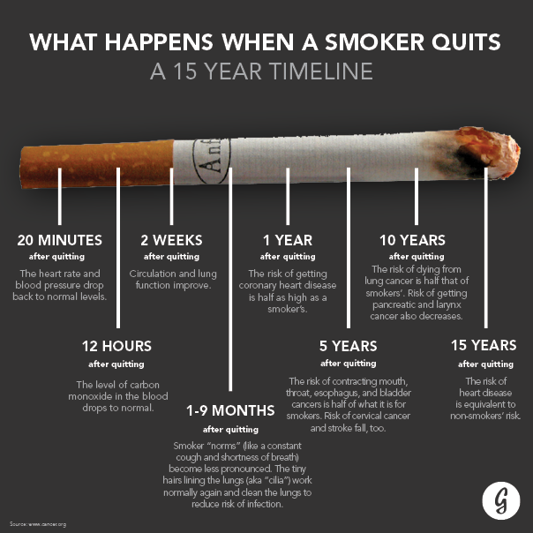
http://greatist.com/health/ultimate-guide-quitting-smoking
Notes:
Here is a schematic showing what happens when a smoker quits. Just 1 year after quitting, the risk for a heart attack drops sharply. Within 2 to 5 years after quitting, the risk for stroke could fall to about the same as that of a nonsmoker’s.
By quitting smoking, the risks for cancers of the mouth, throat, esophagus, and bladder drop by half within 5 years….....
Ten years after quitting, the risk for lung cancer drops by half. …
It is estimated that quitting by the age of 35, will on average, increase life expectancy by 5 years.
Therefore, smokers have great incentive to quit.

Slide 12
Smoking Cessation
Several Methods – used individually or in combination
  “Cold Turkey” without assistance
  Nicotine Replacement Therapy (NRT)
  Prescription Medications
  Behavioral Support
Notes:
When a smoker makes the decision to quit, there are several modalities available that can be used either individually or in combination. Many smokers usually try to quit without assistance from physicians… or without using any smoking cessation aids. Quitting abruptly, also known as “cold turkey” is the most likely initial choice.
The most commonly used medication for smoking cessation is Nicotine Replacement Therapy or (NRT). NRT is available in several different forms, including the Nicotine Patch, gums, Lozenges, or inhaler. They reduce withdrawal symptoms by providing a little bit of nicotine, without any of the other dangerous chemicals found in cigarettes.
For those unable to take NRT or if it is not working, other medications without nicotine are available. These medications can also help reduce withdrawal symptoms and cigarette cravings.
There are also several quitlines available for behavioral and emotional support.

Slide 13
Effectiveness of NRT
Despite the effectiveness of NRT, the relapse rates are high
Reasons behind relapse
E-cigarettes gaining popularity as possible cessation aids
Notes:
Despite the short term effectiveness of NRT, the relapse rates are still rather high, with one study in the British Medical Journal reporting sustained abstinence from smoking – which was defined as not smoking for at least 6 months – to be somewhere in the 4-6% range.
Some of the reasons behind these high relapse rates included: not being 100% ready to quit; suffering from too many withdrawal symptoms, and missing the social aspects of smoking; even just the act of holding a cigarette in one’s hand.
That’s where E-cigarettes started gaining popularity as possible smoking cessation aids, as they imitate the social and behavioral queues of smoking a conventional cigarette, but what do we really know about them?

Slide 14

The Birth of the E-Cigarette
First developed in China by Hon Lik in early 2000’s
Promoted as safer alternative to traditional cigarettes
Appeared on the market in the US in 2006
Creator of the E-Cigarette – Hon Lik
Notes:
E-cigarettes were first developed in China by a pharmacist by the name of Hon Lik, who was himself a heavy smoker. After the passing of his father from Lung cancer related to smoking, he decided it was time for him to quit. He tried high dose nicotine patches but was not having much success. He had a vision of bringing the century old habit of smoking into modern times, while eliminating the health concerns associated with smoking… He pioneered the first e-cigarette in 2003.. and thought if he could develop a safer alternative to conventional cigarettes, he might not have to quit after all, since he enjoyed the act of smoking itself. The first e-cigarette was introduced in the Chinese markets and was promoted as a safer substitute for conventional cigarettes.
E-cigarettes first appeared in the US markets in 2006. They became widely available in kiosks and malls. Popularity has been increasing steadily and there are currently more than 250 different brands, Some of which are designed to look like cigarettes. And appear to simulate the visual, sensory and behavioral aspects of smoking a traditional cigarette. But, they can also take up several other shapes and sizes, including cigars, pipes, or even everyday items like pens or USB memory sticks. There are more than 470 different flavors available on the market.

Slide 15

Notes:
Here is a picture taken from the website of one of the popular companies that makes e-cigarettes called– “blu”. As you can see, several different models and flavors are available and can be bought off the website with the click of a button, as along as you have a credit card in hand.

Slide 16
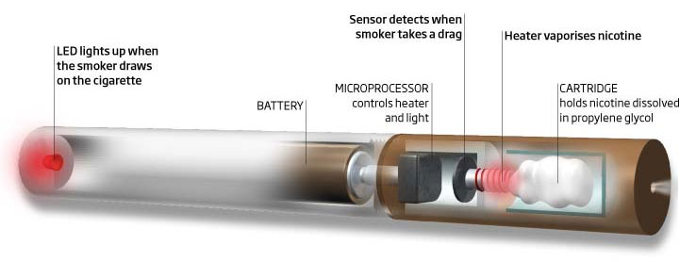
Mechanism of Vaping
Notes:
The E-cigarette has several different components. First, there is the cartridge, which holds the liquid solution containing varying amounts of nicotine. It can also contain flavorings and other chemicals. The second component is the heating device, also known as the vaporizer. There is also a power source, – which is usually a rechargeable battery. In the middle you can see the microprocessor with a sensor that is sensitive to puffing. Some models have an LED diode at the end which imitates the flow of a burning cigarette cone.
Puffing, activates a battery-operated heating element in the vaporizer that is in contact with the cartridge containing the nicotine solution
As a result of increased temperature and airflow, nicotine is vaporized, and an aerosol with droplets of solution is generated and inhaled by the E cigarette user. This is now popularly referred to as Vaping

Slide 17
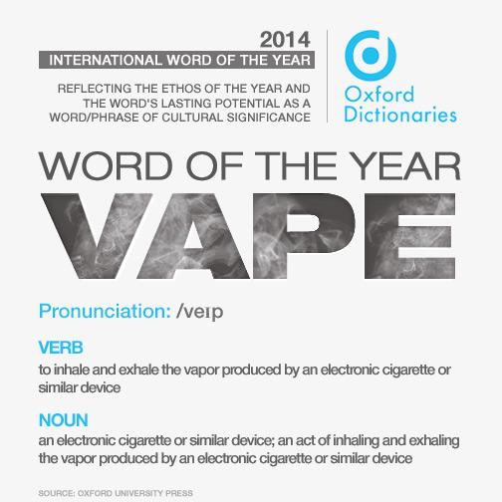
Notes:
For those of you who didn’t know, vaping has become so popular that the word Vape was the winner of the Oxford Dictionary word of the year in 2014, beating out words like ”bae” and “budtender”. As you can see, the competition was very stiff that year….

Slide 18

Marketing
Major tobacco companies join the market in 2012
First time tobacco industry on television in 40 years
Notes:
Initially, E-cigarettes were primarily produced by small manufacturers in China and sold on the Internet without drawing major attention. In 2012, Tobacco giants such as British American Tobacco and Reynolds entered the e-cigarette market. Since then, marketing and sales have sky rocketd.
To come full circle, tobacco product ads were COMPLETELY banned in 1971, and now advertising expenditures for e-cigarettes have increased 3 fold in one year… and For the first time in over 40 years, tobacco companies have been able to put their mark on television and radio broadcasts. Even enlisting celebrities, such as Katherine Heigl and david letterman as supporters of e-cigarettes.

Slide 19
Revenue
Current market
  $2.2 billion in the U.S. alone in 2014
Predictions for the future
  Global market expected to hit $10 billion in 2017
  Industrial economists project that they will surpass conventional cigarettes market in next few decades
Notes:
This increase in advertising has directly lead to the increase in E-cigarette sales. The e-cigarette market in the US alone generated $2.2 billion in revenue in 2014. To put that into perspective, the conventional cigarette market generated $85 billion in that same year. Sales continue to rise steadily, with the global market expected to hit $10 billion in revenue in 2017; with some industrial economists projecting E-cigarettes surpassing conventional cigarette sales in the next 2-3 decades.

Slide 20

Notes:
So we have this new product, it’s flashy, it’s sexy and vastly gaining popularity. The health care industry saw an opportunity to re-define the purpose of e-cigarettes and attempt to use them as smoking cessation aids. but is it is really a safer alternative to smoking?.. And can tbey used as cessation aids even though they weren’t intended for that purpose?

Slide 21
Some Points About the Evidence
Paucity of evidence available at this time
  Only two clinical trials have been completed
Most of the research conducted so far were done on first generation models
  Probably not generalizable to newer models
Notes:
Well, there’s not a whole lot of evidence out there. Only two clinical trials have been completed so far, and 9 others are currently in progress. Some trials are evaluating safety, others are evaluating efficacy. Therefore, the quality of the overall evidence is considered poor at this point. Moreover, both trials used first generation e-cigarettes, which have since been shown to be very ineffective at nicotine delivery.

Slide 22
ECLAT Trial
Notes:
The EffiCiency and Safety of an eLectronic cigAreTte as Tobacco Cigarettes substitute (or ECLAT) was the first clinical trial reported by Caponnetto and his Group from Catania, Italy and was Published in the Public Library of Science in 2013. ECLAT is a Prospective 12-month double-blinded, controlled, randomized clinical study that wanted to evaluate smoking reduction, smoking abstinence, and adverse events in smokers not intending to quit … using two different nicotine strengths of a very popular 1st generation e-cigarette brand called “Categoria”

Slide 23
ECLAT Trial
Regular smokers from Catania not intending to quit were recruited
  June 2010 - February 2011
Advertisements were placed in a local newspaper
offered as a “Healthier Alternative to Tobacco Smoke”
Notes:
Regular smokers between the ages of 18-70, who were in good general health and smoked at least 10 cigarettes per day for the past 5 years were recruited. Advertisements were placed in a local newspaper inviting smokers to try the Categoria e-cigarette.. to reduce the risks of tobacco smoking.. and the E-cigarette was Promoted as a “healthier alternative to tobacco smoke” . It could be freely used as a tobacco substitute, as much as they liked
Exclusion criteria: DO NOT READ, JUST FOR REFERENCE
Symptomatic cardiovascular disease, Symptomatic respiratory disease, Regular psychotropic medication use, Current or past history of alcohol abuse, Use of smokeless tobacco or nicotine replacement therapy, Pregnancy or breastfeeding

Slide 24
Notes:
300 Participants with a median of 25 pack years were equally Randomized to one of three categories
In Group A (POINT)participants received a 12 week supply of 7.2 mg nicotine cartridges
In Group B (POINT), the participants received Two 6-week supplies of cartridges. For the first six weeks, they used cartridges labelled 7.2 mg of nicotine and then switched to cartridges containing 5.4 mg of nicotine.
In Group C (POINT) Participants Received a 12 weeks supply of cartridges that contained no nicotine.
During the baseline visit, Participants had their vitals signs, body weight and adverse events recorded. Additionally, levels of carbon monoxide in exhaled breath (eCO) were measured The particpants were permitted to use the study product as much as they desired throughout the day
In the intervention Phase, Participants were Followed up every 2 weeks. At each follow up visit, Levels of Exhaled Carbon Monoxide (eCO)and Vital signs were assessed. At the end of the intervention phase, no more cartridges would be provided by the investigators, but participants were advised to continue using their e-cigarette if they wished to do so.
In the observation phase, the participants were seen for two more follow up visits at 24 weeks and 52 weeks. They were asked to report e-cigarette use in cartridges/day, as well as the number of tobacco cigarettes smoked. The participants had their exhaled carbon monoxide levels, vital signs and body weight checked. Any adverse events were recorded.

Slide 25
Study Outcome Measures
“Reducers” – A >50% reduction in the number of cigarettes/day from baseline
“Quitters” – Abstinence from smoking
Adverse events – Reported Symptoms
  Thought to be related to tobacco smoking and e-cigarette use
  Withdrawal from nicotine
Notes:
The study had three principle outcomes. “Reducers” were the participants that had a greater than or equal to 50% reduction in the number of cigarettes smoked per day compared to baseline. This was self reported by the participant and not verified biochemically.
“Quitters” were participants who abstained from smoking. This was defined as complete self-reported abstinence from tobacco smoking (not even a single puff) and an exhaled carbon monoxide concentration of < 7 parts per million since the previous study visit
Adverse events, which were symptoms thought to be either related to tobacco smoking ,e-cigarette use or to withdrawal from nicotine were recorded at each visit

Slide 26
Notes:
This figure shows the changes in the total number of reducers and quitters over the course of the study. There was no statistically significant difference observed among the three study groups in reduction and quit rates, so all three groups are combined in this graph. Overall, switching to e-cigarettes resulted in significant smoking reduction and smoking abstinence.
33% of the participants were either quitters or reducers at week 12, while 19.0% were combined quitters or reducers at week 52.

Slide 27
Reduction in cigarettes/day
Figure 4: Time course of changes in the median number of
cig/day use from baseline, separately for each study group
Notes:
This graph shows the median number of cigarettes smoked per day over the duration of the study. At baseline, the mean overall cigarette consumption was 21.4 cigarettes per day. There was A significant reduction of median value in cigarette use per day from baseline at each study visit in all three of the study groups (per protocol evaluation, p<0.0001).
At weeks 2, 6 and 8, there was a statistically significant decrease in the number of cigarettes smoked per day in the nicotine groups as compared to the non-nicotine group. The mean overall cigarette consumption decreased to 13.9 cigarettes/day at week 52 (p<0.0001). But as you can see, after two weeks, the number of cigarettes smoked per day started steadily trending upwards.

Slide 28
Abstinence
At Week 12, complete abstinence from tobacco smoking was documented in 14% when combining the nicotine groups and 4% in the non-nicotine group (p=0.008)
At Week 52, 11% Group A/B (nicotine) vs 4% in Group C (no nicotine) (p=0.04)
26.9% of quitters were still using the e-cigarette by the end of the study
Notes:
At Week 12, complete abstinence from tobacco smoking was documented in 14% when combining the nicotine groups and 4% in the non-nicotine group. This was statistically significant. (p=0.008)
Of these quitters, nearly a third were still using the e-cigarette by the end of the study

Slide 29
Adverse Events
Figure 8. Time-Course of Changes in the frequency of the five most commonly
reported adverse events (AE) from baseline, separately for each group study
Notes:
Now, let’s talk about the adverse events. Before using e-cigarettes at baseline, the five most frequently reported adverse events were dry cough which was reported (26%), dry mouth reported by (22%), shortness of breath, reported by (20%), throat irritation, and headache. Not only were there no major adverse events in this study, but there was noted to be a significant reduction in frequency of the symptoms that were reported at baseline by the end of the trial.
Shortness of breath for example, was substantially reduced from 20% to 4% already by week 2. The authors thought that this was more likely due to abstinence or reduction in cigarette consumption, rather than the effect of the e-cigarette itself

Slide 30
Adverse Events
Withdrawal symptoms uncommon
No serious adverse events occurred during the study
  Major depression
  Abnormal behavior
  Any event requiring unscheduled visit to the family practitioner or hospitalization
No significant changes in mean body weight, resting heart rate, systolic/diastolic blood pressure
Notes:
In addition, The side effects commonly recorded during previous smoking cessation trials were infrequently reported throughout the course of this study. These included symptoms like Hunger, insomnia, anxiety and depression.
No serious adverse events were recorded during this study, as mentioned earlier.
Furthermore, there were No significant changes in mean body weight, resting heart rate, systolic or diastolic blood pressure.
However, the authors cautioned that the participants were only followed up for 1 year and long term data on adverse effects are needed before any conclusions can be drawn. In addition, 40% of the participants were lost to follow up, so some adverse events might not have been captured.

Slide 31
How do they compare to NRT?
Notes:
To recap, the first clinical trial demonstrated that e-cigarettes hold promise in serving as a means for reducing the number of cigarettes smoked and can lead to abstinence from smoking, but it hadn’t been tested against other FDA approved smoking cessation aids like nicotine gum or patches, and that’s where the second study comes in.

Slide 32
Notes:
The second trial was published in the lancet in late 2013 and was conducted in New Zealand.
The main hypothesis of this trial was that Nicotine e-cigarettes would be superior than patches or placebo e-cigarettes for smoking reduction, tobacco dependence, and relief of withdrawal symptoms, and that they would have no greater risk of adverse events than nicotine patches

Slide 33
Study Methods
657 participants randomized 4:4:1 ratio
  Nicotine E-Cigarettes, Patches or Placebo
Elusion e-cigarettes
  Nicotine cartridges - 16 mg/ml nicotine
  Vapor analysis done midway through the trial
    300 puffs from one nicotine e-cigarette cartridge delivered 3-6 mg nicotine
Nicotine patches - 21 mg/24hr
Notes:
657 participants who were older than 18 years of age, who smoked more than 10 cigarettes per day for the past year and who HAD the intention to quit were recruited via newspaper ads and randomized in a 4:4:1 ratio to receive either nicotine e-cigarettes, nicotine patches or placebo e-cigarettes
This trial used the Elusion e-cigarettes which were among the most popular e-cigarette models at the time in Australia and New Zealand.
The Nicotine cartridges contained 16 mg/ml of nicotine. Vapor analysis was done midway through the trial and showed that 300 puffs from one nicotine e-cigarette cartridge delivered about 3-6 mg of nicotine, which is equivalent to smoking between one and five tobacco cigarettes
The Nicotine patches that were used contained (21 mg over 24hr). This was the most popular NRT product in New Zealand at the time
Exclusion criteria: DO NOT READ, FOR REFERENCE ONLY
Pregnant and breastfeeding women
People using cessation drugs or in an existing cessation program
Those reporting heart attack, stroke or severe angina in the previous 2 weeks
Those with poorly controlled medical disorders, allergies or other chemical dependence
Participants’ baseline characteristics were evenly balanced between treatment groups
Overall loss to follow up was 22%, highest in the group that received patches (27%)

Slide 34
Study Outcomes
Primary Outcome
Secondary Outcome
Continuous smoking abstinence 6 months after quit date
Verified by E_{CO} measurement (<10 ppm)
Number of tobacco cigarettes smoked per day
Proportion of participants reducing tobacco smoking by 50%
Time to relapse to tobacco smoking
Notes:
The primary outcome was continuous smoking abstinence at 6 months. This was defined as self-reported abstinence over the whole follow-up period, while allowing less than 5 cigarettes in total, at 6 months after the participants chosen quit date. Abstinence was verified by an exhaled breath carbon monoxide level of less than 10 parts per million. There were many secondary outcomes that were assessed in this study. I will only mention a few…. the Number of tobacco cigarettes smoked per day, the Proportion of participants reducing tobacco smoking by more than 50%, the Time to relapse to tobacco smoking and any adverse events.

Slide 35
Results
Verified continuous abstinence at 6 months
  Nicotine e-cigarettes group (7.3%)
  Nicotine patches (5.8%)
  Placebo e-cigarettes (4.1%)
Achievement of abstinence was substantially lower than anticipated
  The study had insufficient statistical power to conclude superiority
Notes:
Let’s look at the results For the primary outcome of the study. The Verified continuous abstinence rate at 6 months after quit day was highest in the nicotine e-cigarettes group, where it was noted to be (7.3%). This was followed by the patches group at (5.8%) and lastly 4.1% in the placebo e-cigarette group. While these were promising results for nicotine e-cigarettes, the study had insufficient statistical power to conclude superiority of nicotine e-cigarettes to patches or placebo e-cigarettes.
This was due to the fact that Achievement of abstinence was substantially lower than anticipated

Slide 36
Secondary Outcomes
Median time to relapse (p<0.0001)
  35 days in the nicotine e-cigarettes group vs. 14 days in the patches group
Mean cigarette consumption (p = 0.004)
  Decreased by 2 cigarettes per day more in the nicotine e-cigarette vs patches
>50% reduction in daily cigarette use at 6 months (p = 0.002)
  57% in the nicotine e-cigarette group
  41% in the patches group
Notes:
In this study, the Quit rates were initially high then decreased in all groups. Most participants relapsed within 50 days. The Median time to relapse in the nicotine e-cigarettes group was 35 days, more than twice as long as in the patches group (14 days, p<0.0001)
Mean cigarette consumption significantly decreased by 2 cigarettes per day more in the nicotine e-cigarette group than in the patches group p =0.004
Additionally, In the nicotine e-cigarette group, 57% of the participants reduced daily cigarette use by at least half at 6 months which was significantly higher than the 41% seen in the patches group p=0.002

Slide 37
Adverse Events
A higher number and proportion of adverse events occurred in the nicotine e-cigarettes vs patches
  Not associated with study product
  Not statistically significant
  Most common were dry mouth and throat irritation
Notes:
As for the adverse events, A higher number and proportion occurred overall in the nicotine e-cigarettes group compared with the patches group. However, these adverse events were not directly linked with the study product and the difference was not statistically significant. The most common adverse events were dry mouth and throat irritation.

Slide 38
Long-Term Use
Continued use after abstinence
  Among those in the nicotine e-cigarette group verified as abstinent, 38% were still using e-cigarettes at 6 months
“Dual Users”
  Among non-quitters, 29% were “dual users” at 6 months
  Reduced daily cigarette consumption
Notes:
Interestingly, The authors noted that A third of the participants allocated to both e-cigarette groups reported continued product use at 6 months, suggesting that they might have made the switch to long-term e-cigarette users
In addition, In those that were randomized to the nicotine e-cigarette group who were not abstinent at 6 months, 29% were still using e-cigarettes at 6 months. These were called “dual users”. However, this group of dual users had significantly reduced their daily cigarette consumption.

Slide 39
Conclusions
Nicotine e-cigarette use resulted in increased abstinence at 6 months compared with use of patches or placebo e-cigarettes
  Not statistically significant
Post Hoc Analyses evaluated non-inferiority
  Nicotine e-cigarettes were as effective as patches
No difference in adverse events with e-cigarettes compared with patches
Modest abstinence rates overall
Notes:
So to recap, The authors concluded that 13 weeks of nicotine e-cigarette use resulted in increased abstinence at 6 months compared with use of patches or placebo e-cigarettes. While the results were promising, they were not statistically significant as the study was underpowered to show superiority of nicotine E-cigarettes over patches.
Post Hoc Analyses were done to evaluate non-inferiority, and showed nicotine e-cigarettes were at least as effective as patches.
The authors cautioned that while there was No difference in adverse events with e-cigarettes compared with patches, this was only in short term followup and long term follow up was needed
This study had modest abstinence rates which might have been due to inadequate nicotine delivery from the first generation e-cigarettes and the authors speculated this to be less of a problem with newer generations. Additionally, there was higher loss to follow up in the patches group; and the authors questioned whether smokers agreed to take part in the study just to try the e-cigarette itself and lost interest when randomized to the patches group.

Slide 40
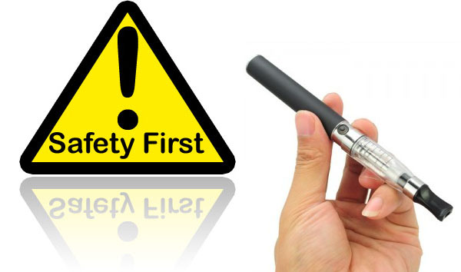
Notes:
Now that we’ve heard about the trials that looked at effectiveness of e-cigarettes as smoking cessation aids, let’s shift gears a little bit and talk about some of the short-term and long-term adverse effects associated with e-cigarettes. Are they really safer alternatives to conventional cigarettes? Let’s start with some key points about safety.

Slide 41
Key Points about Safety
No firm conclusions can be drawn on the safety of E-cigarettes
  Relatively few and often small studies
  Many inconsistencies and contradictions
  Many methodological problems
  Severe conflicts of interest
  Lack of long-term follow up
Notes:
No firm conclusions can be drawn on the safety of e-cigarettes for multiple reasons. First, there are only relatively few and often small studies done that looked at safety. In addition, A lot of the studies had many inconsistencies and tended to contradict one another. Most importantly though, none of the studies followed patients long term, with most studies stopping after 1 year of follow up. A lot of the questions about the long term effects of smoking might not be answered for a few more decades, as chronic diseases and cancers do not develop overnight.

Slide 42
Key Points about Safety
Research applies to the specific E-cigarette being tested
Mechanism of E-cigarette use different than smoking conventional cigarettes
Misleading information on product ingredients
Human experiments based on short-term exposure
Notes:
In addition, Any research only applies to the specific E-cigarette brand model and batch being tested, with no certainty that the findings will apply to other or future products.
Also, the mechanism of smoking an e-cigarette is significantly different than smoking conventional cigarettes – with E-cigarette users having longer puffing durations and harder puffs than conventional cigarette smokers. Therefore, we might be underestimating effects when testing on E-cigarette-naïve volunteers or when using smoking machines which a lot of these studies used. Finally, The Human experiments that were conducted were mostly based on very short-term exposure, for example, vaping for a few minutes only, and this does not necessarily reflect real life exposure.
With all these points in mind, let’s talk about some of the main components in e-cigarettes and their associated effects on the e-cigarette smoker and bystanders.

Slide 43
Main Components
Notes:
This is a pie chart showing the main components found in the liquid solution and the aerosol vapor from e-cigarettes. Propylene glycol and glycerin are the two main components in the liquid solution. But varying amounts of nicotine, flavorings and other substances have been found. Let’s talk about some of these in more detail.

Slide 44
Propylene glycol
Generally Recognized as safe for inhalation in humans
Some reported events
  Exposure can cause eye and respiratory irritation When heated
  In children, chronic exposure may increase or induce rhinitis( nasal irritation), asthma, eczema and allergic symptoms
  Acute and chronic respiratory effects, including reduced lung function
Notes:
Propylene glycol is the Main component of the liquid solution and Creates the visible fumes we see when the vapor is exhaled. It has been used in theaters to create fog for special effects and is also a solvent used in many pharmaceutical products. It is Generally recognized as safe for inhalation in humans by the FDA.
However, several adverse events related to propylene glycol exposure have been reported. First, Exposure to propylene glycol can cause eye and respiratory irritation When heated. In addition, chronic exposure to propylene glycol in indoor air was shown to either exacerbate or induce rhinitis, asthma, eczema and allergic symptoms in children.
Furthermore, in workers chronically exposed to theatre fogsl, Acute and chronic respiratory effects, including reduced lung function, have been reported

Slide 45
Other Substances
Many Harmful substances found in lower concentrations
  Tobacco-specific nitrosamines
  Diethylene glycol
  Formaldehyde
  Heavy metals
  Cytotoxic flavorings
  Acrolein
One experimental in vitro study found that EC vapor can change gene expression in a similar way to tobacco
Notes:
Many Harmful substances have been found in lower concentrations than in conventional cigarettes; ranging anywhere from 9-fold to 450 fold lower concentration.
In 2009, The FDA analyzed the ingredients in a small sample of cartridges from two leading brands of e-cigarettes. One sample was found to contain very low levels of diethylene glycol, a toxic chemical used in antifreeze. However, diethylene glycol has not been found again.
Several other samples were found to contain carcinogens including tobacco-specific nitrosamines. This has been replicated in many studies.
Several studies have found some heavy metals including cadmium, tin and nickel. They were anywhere between 10-50 times below the levels allowed in inhalation medicines, and the clinical significance of the presence of these metals at those levels is not known.
The group 1 carcinogen Formaldehyde has been found in several studies, with levels as high as in the smoke produced by some cigarettes reported in one study.
Aerosol from one e-cigarette liquid was cytotoxic. This was thought to be due to the cinnamon flavoring. However, the cinnamon flavoring was noted to be 800 times less cytotoxic than tobacco.
Acrolein, which has been associated with increased risk of lung cancer, was detected in the aerosol of some E-cigarette brands, but at levels much lower than in cigarette smoke. Acrolein is produced when glycerin is heated to high temperatures.
Let’s move on and talk about some general points about nicotine, some of the factors that affect it’s delivery and some of the adverse effects associated with it

Slide 46
Nicotine
Addictive chemical in tobacco smoke
  Mild psychomotor stimulant
Not involved in smoking-related harm
Long term negative consequences for brain development
Spike in phone calls to poison control centers
Notes:
Nicotine is the Addictive chemical in tobacco smoke. It is a Mild psychomotor stimulant that supports repeated self-administration as well as the development of drug dependence. It’s generally not considered to be involved in smoking-related harm. However, there is sufficient evidence that exposure to nicotine can have negative long term effects on developing brain tissue, including problems with learning, memory, attention, behavior and future addictions.
Since the introduction of e-cigarettes, there has been a spike in phone calls to poison control centers, with people reporting either exposure to the e-liquid itself, or complaining of signs of nicotine overdose… either from vaping alone or in combination with smoking conventional cigarettes by dual users.
So how much nicotine is actually delivered from the liquid of e-cigarettes?

Slide 47
Factors affecting nicotine delivery
Nicotine content of a cartridge
  0 -36 mg/ml
The efficacy of the vaporization process
  0.77 mg e-cigarette vs 1.54-2.60 mg conventional
Bioavailability of nicotine from the aerosol is a key factor
Notes:
Several factors affect how much nicotine is delivered from the liquid to the user’s bloodstream. The Nicotine content of a cartridge ranges 0-36 mg nicotine/ml. But how much of that actually makes into into the aerosol is determined by the vaporization process – with factors like size and voltage of the battery, the nature of the heating element and the experience of the e-cigarette user contributing to the efficiency of this process.
In a study reported in the Journal of Nicotine and Tobacco Research, 16 popular e-cigarette brands of varying nicotine strengths were evaluated for nicotine levels in the cartridge and vapor itself. Nicotine delivery was widely inconsistent and brand dependent. Generally speaking, 15 puffs from an e-cigarette is universally accepted to be equal to smoking 1 conventional cigarette. In this study, 20 series of 15 puffs ( or roughly one pack of cigarettes) delivered only 50-60% of the nicotine from the cartridge to the vapor. To give you a rough idea, smoking one conventional cigarette delivers anywhere from 1.54 to 2.60 mg of nicotine to the smoker, the highest any of the brands delivered was 0.77 mg.
Let’s look at how e-cigarettes have evolved.

Slide 48
Evolution
Notes:
Shown here are examples of different generations of e-cigarettes. On the left are The first generation devices, also known as the cigalike models since they closely resemble tobacco cigarettes. They are lightweight, and have limited flavor assortments. They are equipped with low-capacity batteries and are notoriously known for not delivering nicotine effectively.
In the middle are the second generation devices which usually resemble a pen or a laser pointer. They are equipped with high capacity batteries and have more efficient vaporizing systems that can be refilled with the users liquid of choice.
The third generation e-cigarettes are more advanced and can be personalized by adjusting various components to achieve top performance. They do not resemble tobacco cigarettes and are heavyweight because of their larger-capacity batteries. They can be pretty efficient at delivering nicotine. There has also been a 4th generation device, not shown in this picture. They were added to the US market in 2014; with the added feature of being able to control the temperature of the device and thus personalize it even further.

Slide 49

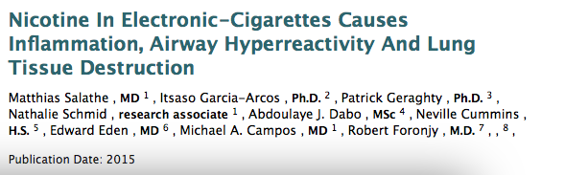
Effects on Respiratory System
Notes:
In abstracts reported in both the American Thoracic Society and the European Respiratory Journal, an In-vivo model of e-cigarette exposure was used in mice. The mice were exposed for 1 hour/day, 5 days a week, for 4 months to vapor created by a smoking machine equipped with either an 18 mg /ml nicotine liquid or liquid containing no nicotine at all. The authors showed that the vapor from the nicotine cartridge induced emphysema, airway hyperreactivity and tissue destruction in the lungs of these mice. However, no similar effects were seen in the mice exposed to vapor from the no-nicotine cartridge. Thus, implicating nicotine as a major factor in airway disease development.
Aside from the effects of nicotine, the vapor itself as a whole has been shown to have negative effects on the respiratory system.

Slide 50
Effects on Respiratory System
Varvadas et al – No effect on pulmonary function via spirometry
  Statistically significant increase in lung impedance, peripheral airway flow resistance and oxidative stress
One case of lipoid pneumonia that resolved after stopping e-cigarette use
Notes:
In a study published by Varvadas et al in Chest in 2012– 30 healthy adult volunteers in Greece who were active cigarette smokers were asked to use e-cigarettes for 5 minutes. They wanted to see the effect on pulmonary function tests and the fraction of exhaled nitric oxide – which is a noninvasive marker of bronchial inflammation. The Control group was 10 smokers who were asked to use an e-cigarette without a cartridge, and thus no vapor was produced. Pulmonary function assessed via spirometry did not change in either group
However, the authors noted a Statistically significant Increase in lung impedance, peripheral airway flow resistance (as measured by oscillometry) and oxidative stress (FENO), all thought to be secondary to the vapor itself. However, the clinical significance of these findings remains unclear, but The Authors emphasized that if these changes occurred after 5 minutes of exposure, long term effects need to be carefully studied
And for completions sake, there is also one case report of an e-cigarette smoker developing lipoid pneumonia which completely resolved after stopping e-cigarette use.
What about the effect of the e-cigarettes on bystanders.

Slide 51
Effects on bystanders
Most second-hand smoke from cigarettes is generated as side stream smoke from the tip of the cigarette.
Bystanders inhale exhaled vapor
  Nicotine, flavors, glycerol and Propylene glycol
  Does not include most chemicals found in tobacco smoke
No long-term study has been conducted so far
  but pollutant levels are much lower than from cigarettes
Notes:
Second hand smoke from conventional cigarettes is generated as side stream from the tip of the cigarette.
E-cigarettes do not generate side stream aerosol. Only the vapor that is exhaled by users is what enters the ambient air.
Users exhale nicotine, flavors, aroma transporters, glycerol and propylene glycol. It is unclear if the increased exposure to toxins and particles in exhaled aerosol will lead to an increased risk of disease or death among bystanders, as does the exposure to tobacco smoke.
No long-term studies have been conducted so far, but toxin levels are much lower than from cigarettes and are likely to pose a much lower risk (if any) compared to cigarettes. Aside from all the negative effects on the e-cigarette user and bystanders that we have discussed so far, there is one last potential complication that I want to mention…

Slide 52


Explosions
29 year old man was in critical condition in a Colorado Springs hospital after an electronic cigarette exploded in his face
Notes:
There’s the dreaded complication of the e-cigarette exploding. Here are two pictures of e-cigarette smokers who had their e-cigarettes explode in their faces.
on the left, a 29 year old Memphis native, was in critical condition after an electronic cigarette exploded in his face. He suffered a broken neck, burns on his mouth and a broken tooth. On the right, is a young man in Florida who had to be placed in a medically induced coma after suffering critical injuries from an exploding cigarette.
There have been at least 22 e-cigarette fires since the devices hit the market in 2006, including A man from Kentucky who suffered severe burns in his legs when an e-cigarette battery caught fire in his pocket

Slide 53

Notes:
I guess we can safely conclude that e-cigarettes are not as healthy for you as advertised, even if you chose the fruit salad flavor. This among many reasons is why the World Health organization and many other public health organizations have brought up several concerns about e-cigarettes.

Slide 54
Public Health Concerns
World Health Organization – Report 2014
  Re-normalization of Smoking
  Adolescents and gateway to smoking
  Unknown long term effects
  No Federal Regulation
Notes:
The renormalization effect refers to the possibility that everything that makes E-cigarettes attractive to smokers may enhance the attractiveness of smoking itself and perpetuate the smoking epidemic. Marketing campaigns for e-cigarettes threaten to reverse the successful, decades-long public health campaign to denormalize smoking.
The gateway effect refers to the possibility that children (and non-smokers in general) may be exposed to nicotine by experimenting with e-cigarettes and once addicted, they will end up switching to cigarette smoking. Experimentation with e-cigarettes is increasing rapidly among adolescents and that in itself is of great concern, even if most of the young e-cigarette users also smoke.
E-cigarettes are not regulated by the federal government. However, In April 2014, the FDA proposed new regulations for tobacco products, including e-cigarettes. The regulations require disclosure of ingredients used in e-cigarette liquids, proof of safety of those ingredients, and regulation of the devices used to vaporize and deliver the liquid. The FDA proposed regulation would ban the sale of e-cigarettes with nicotine to any individual under 18 years of age.
In March 2016, the DOT prohibited use of e-cigarettes on commercial flights in order to "protect airline passengers from unwanted exposure to aerosol fumes". This applies to all flights to, from, and inside the U.S.
Currently, e-cigarettes are only regulated under state laws.

Slide 55
New York State and City Law
California – Department of Health
    This law prohibits the sale of tobacco products (under the age of 21)
  Liquid Nicotine Sales and Packaging
    Prohibits the sale of liquid nicotine to minors
    All liquid nicotine is to be packaged in a child-resistant bottle
Califonia Law
  E-cigarettes are included in the Smoke-Free Air Act.
Notes:
In California, the department of Health has included e-cigarettes under the tobacco laws
which was initially Enacted in 1992 and prohibits the sale of tobacco products any one under the age of 21.
The department of health also prohibits the sale of liquid nicotine to minors. Businesses that sell liquid nicotine are required to have specific signs indicating that the sale of this product to minors is prohibited. All liquid nicotine is required to be packaged in a child-resistant bottle designed to prevent accidental exposure; with Violators subject to a civil penalty of up to $1,000.
This act prohibits the use an e-cigarette in places where smoking is banned. That includes bars, restaurants, offices, parks, and beaches. In addition, Retailers are not allowed to sell tobacco products and electronic cigarettes to anyone under the age of 21.

Slide 56
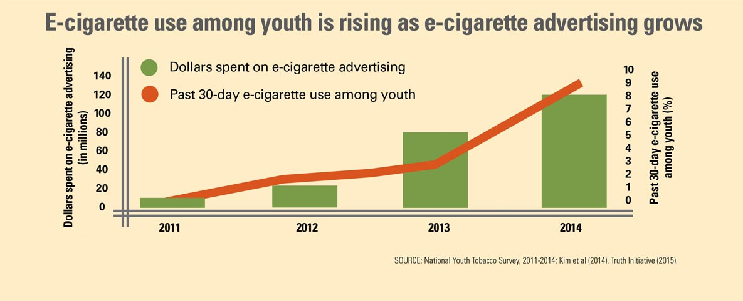
Notes:
18 million ( 7/10) US Middle and High School youth were exposed to e-cigarette ads in 2014
1in 2 middle and high school youths exposed to e- cigarette ad in retail store
2 in 5 middle and high school youth saw an e-cigarette ad online
$6.4 million on ads in 2011
$115 million in 2014
Involve themes of sex, independence, and rebellion
Did it work: Middle school ( 1% to 4%) and High School (2% to 13%)

Slide 57
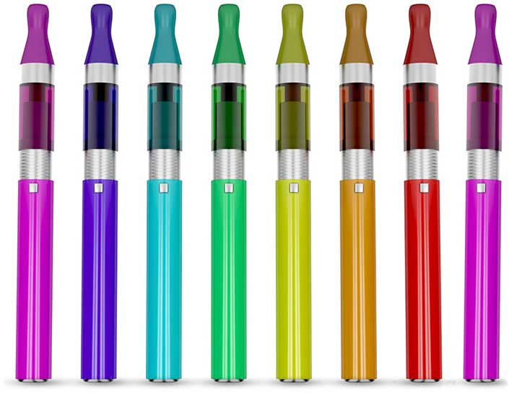
More than 18 million (7 in 10) US middle and high school youth were exposed to e-cigarette ads in 2014.
More than 1 in 2 middle and high school youth were exposed to e-cigarette ads in retail stores.
Nearly 2 in 5 middle and high school youth saw e-cigarette ads online.

Slide 58
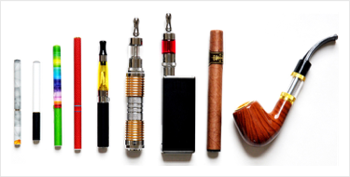
What do they look like:

Slide 59


In Our Area

Slide 60
Future:
Youth (12-17 yrs) in a longitudinal Study
Those who used e-cigarette
25% to 50% more likely to use Marijuana later in their youth
The effect of the Marijuana on the developing Brain???
Dai, H et al. Pediatrics April 2018
Notes:
In a recent study in the Journal of Pediatric, Dai and authors found that the youth that used a e-cigarette were 25% to 50% more likely to use marijuana later in their youth.
There is clear data that marijuana affect the the developing brain.

Slide 61
Summary
E-cigarettes introduced in the US in 2006
Sales skyrocketed after Big Tobacco became involved in 2012
Paucity of evidence
Might be as effective as patches but not superior
Many harmful chemicals were found in vapor
Long terms effects are still unknown

Slide 62

Final Thoughts:

Slide 63

Take Home Points
Do not recommend E-cigarettes to nonsmokers
E-cigarettes have not been proven to be effective as smoking cessation aids
Advise against dual using
The long term effects will not be known for a few more decades
Let’s not repeat the same mistakes of the 1960’s!

Slide 64

Thank You For Listening!
Notes:
Thank you for listening.

Slide 65
References
Bullen et al. Electronic cigarettes for smoking cessation: a randomised controlled trial. Lancet 2013, 382: 1629-37
Capponetto et al (2013) Efficiency and Safety of an Electronic Cigarette (ECLAT) as Tobacco Cigarettes Substitute: A Prospective 12-Month Randomized Control Design Study. PLoS ONE8(6): e66317
Pisinger et at. A systematic review of health effects of electronic cigarettes. Preventative Medicine 69 (2014): 248-260
Hajek et al. Electronic cigarettes: a review of use, content, safety, effects on smokers and potential for harm and benefit. Addiction 2014
Goniewicz et al. Nicotine Levels in Electronic Cigarettes. Nicotine and Tobacco Research 2010
Electronic nicotine delivery systems. Report by WHO-FCTC 2014
Varvadas et al. Short-term Pulmonary Effects of using an Electronic Cigarette. Chest 2012; 141(6): 1400-1406
Salathe et al. Nicotine in Electronic-Cigarettes Causes Inflammation, Airway Hyperreactivity and Lung Tissue Destruction. Am J Respir Crit Care Med 191; 2015:A4030
Leventhal et al. Association of Electronic Cigarette Use with Initiation of Combustible Tobacco Product Smoking in Early Adolescence. JAMA 2015; 314(7): 700-707
McRobbie et al. Electronic cigarettes for smoking cessation and reduction (Review). The Cochrane Database of Systematic Reviews 2014, Issue 12
Drummond. Electronic Cigarettes: Potential Harms and Benefits. Ann Am Thorcic Soc 2014 Vol 11, No 2 pp 236-242
BMJ 2009;338:b1024

Slide 66

Notes:
Let’s just say the E-cigarette makers have gone all in on making the newer models as efficient as possible at delivering nicotine. Let’s just hope they don’t actually taste like black jack cards, whatever that tastes like. So is nicotine really that harmless? Let’s look at some of the adverse effects of nicotine on the respiratory system.

